Slide 1

Quantum Physics for Engineers
18PH4101
IV/IV B.Tech, I Semester
2021-22
Dr. Mahamuda Shaik
Associate Professor
Department of Physics

Slide 2

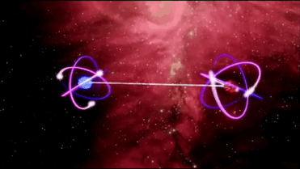

Slide 3
Syllabus
CO-1: Elements of Solid state Physics
CO-2: Quantum concepts
CO-3:Schrodinger Wave Mechanics
CO-4: Special Theory of Relativity

Slide 4
CO1: Elements of solid-state Physics: Crystal structure, Band theory, Semiconductors, Principles oflasers: Spontaneous and induced emission – Lasing action – Ruby laser – Semiconductor laser- applications.
CO2:Quantum concepts: Bohr model, Black body radiation, particle nature of light, photoelectric effect, Compton effect,matter waves, wave packets, phase and group velocity, Davisson Germer experiment, Heisenberg uncertaintyprinciple. CO3: Schrödinger wave Mechanics: Schrodinger wave equation, probabilistic interpretation of wavefunction, superposition principle, Hermitian operators. One dimensional problem: particle in a box, potential well,potential barrier, and tunneling.
CO4: Special theory of relativity: Frame of reference - Galilean and Lorentztransformation, Postulates of the special theory of relativity - space-time viewpoints, a variation of mass withvelocity - energy-momentum conservation.

Slide 5
Evaluation Plan
Evaluation Type (100M)
In-Semester (60%)
Summative
(35M)
Formative (25M)
End Semester (40%)
End Sem Theory (24M)
In-Sem-I (17.5M)
In-Sem-II
(17.5M)
ALM (10M)
HA (10M)
Attendance (5M)
End Sem Lab (16M)

Slide 6

Crystal Structures

Slide 7
Session 1

Slide 8
Matter
LIQUIDS
GASES
SOLIDS
Classification of matter
Amorphous
Qusicrystals
Crystals
Polycrystals
Single Crystals

Slide 9
Crystalline Solids
Amorphous Solids
Regular arrangement of atoms along the 3 D.
Have long range order.
Sharp melting point.
High and fixed heat of fusion.
They are anisotropic.
They show all characteristic of solids.
They have regular cut.
No regular arrangement of atoms.
Have short range order.
No sharp melting point.
No fixed heat of fusion.
They are isotropic.
They don’t show all characteristics of solids.
They give irregular cut.

Slide 10
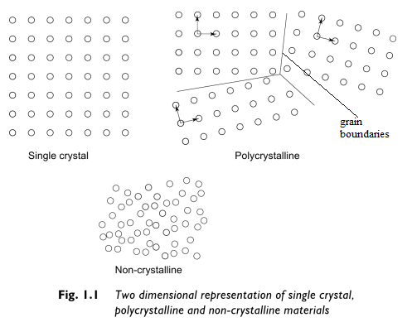
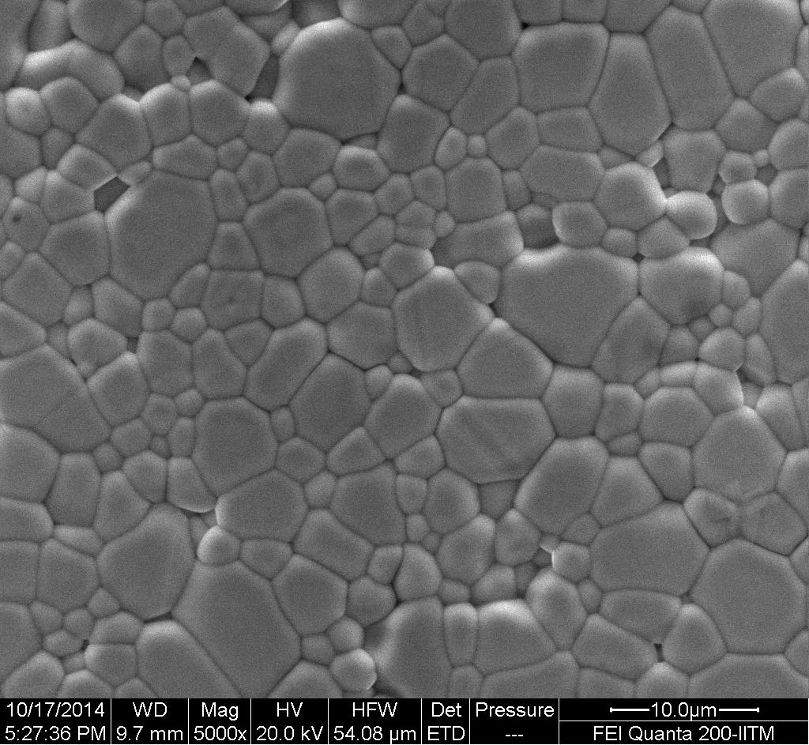
Two dimensional representation of Single, poly crystalline and amorphous materials

Slide 11
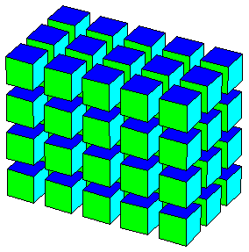
Basic Definitions
Lattice
Plane Lattice
Linear Lattice
Space Lattice
a
An infinite array of points
Each point will have
Identical surrounding.
y
Translation vector
b
B
x
O
a
2

Slide 12
Basis
A group of atoms (or ions) which when attached
to every lattice points produces the crystal structure.
Basis
Lattice + Basis = Crystal structure

Slide 13
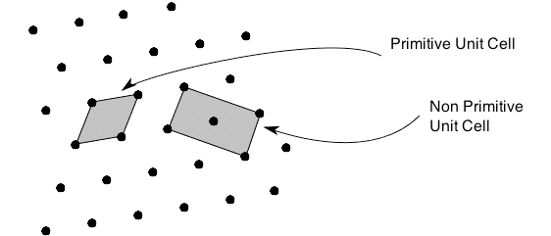
Unit Cell:
The building block of the crystal consisting of atoms, ions or
molecules which when translated along the three axes gives
the actual crystal structure. It should occupy a minimum
volume.
Smallest repeatable unit in a point Lattice.
Choice of unit cell is not unique
There are two distinct types of unit cell:
Primitive unit cell
Non-primitive unit cell

Slide 14
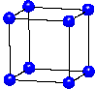
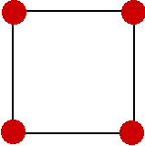
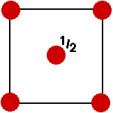
UNIT CELL
Primitive
Non-primitive
Single lattice point per cell
Smallest area in 2D, or
Smallest volume in 3D
More than one lattice point
per cell
Integral multibles of the are
of primitive cell
Simple cubic(sc)
Conventional = Primitive cell
Body centered cubic(bcc)
Conventional ≠ Primitive cell

Slide 15
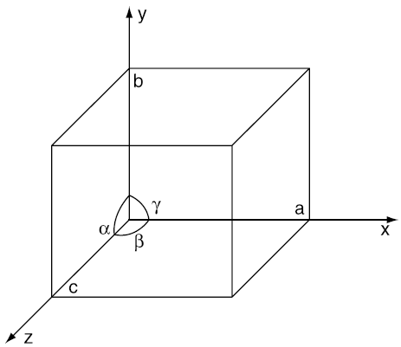
Crystallographic axes
Axes resulted by the intersection of the three non-coplanar
faces of the unit cell.
The angles between these faces or crystallographic axes
are known as interfacial or inter-axial angles.
Lattice parameters
The translational vectors (or primitives) a, b, c of a unit cell
along X, Y, Z axes and inter-axial angles α, β, γ
α : Angle between the axes Y and Z
β : Angle between the axes Z and X
γ : Angle between the axes X and Y

Slide 16
Crystal systems
1. Cubic Crystal System
a = b = c
α = β = γ = 90°

Slide 17
2.Tetragonal system
a = b ≠ c
α = β = γ = 90°

Slide 18
3. Orthorhombic system
a ≠ b ≠ c
α = β = γ = 90°

Slide 19
4. Monoclinic system
γ
a ≠ b ≠ c
α = γ = 90°, β ≠ 90°

Slide 20
5. Triclinic system
α
β
γ
a ≠ b ≠ c
α ≠ β ≠ γ ≠ 90°

Slide 21
6. Rhombohedral (Trigonal) system
a = b = c
α = β = γ ≠ 90°

Slide 22
7. Hexagonal system
a = b ≠ c
= β = 90°, γ = 120°

Slide 23
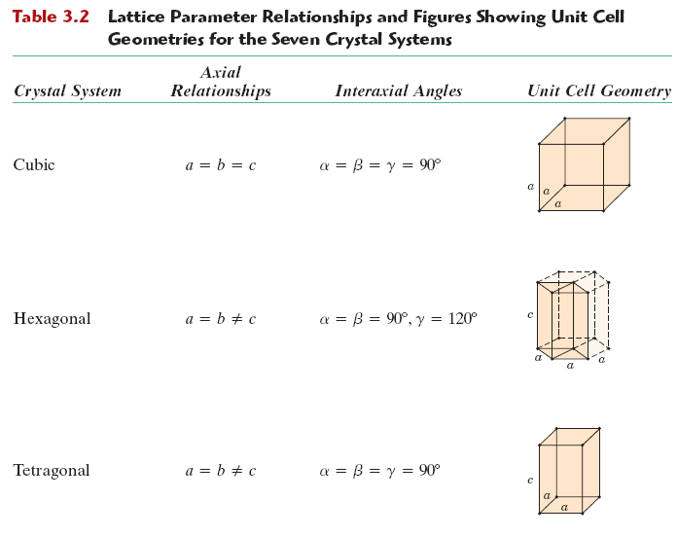
Summary of crystal systems

Slide 24
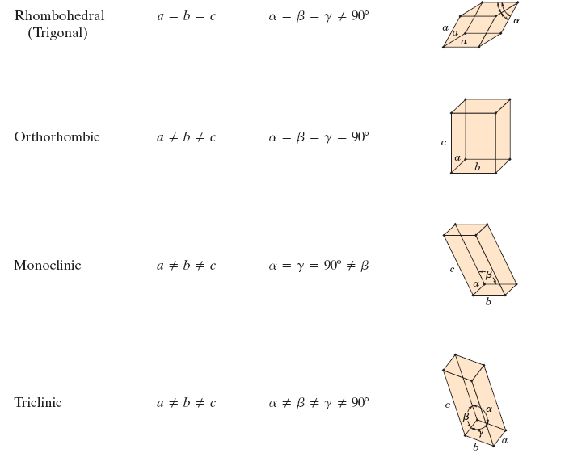
Click here Crystal systems

Slide 25
Session 2

Slide 26
Bravais Lattice
An infinite array of discrete points generated by a set of discrete
translation operations described by
where n_{i} are integers and a_{i} are primitive vectors
14 Bravais lattices are possible in 3-dimentional space.
These are obtained by combination of lattice system with lattice
types
Lattice system (crystal system): gives the information regarding
the lattice parameters
Lattice types: Gives the information about lattice points present
in the unit cell.

Slide 27
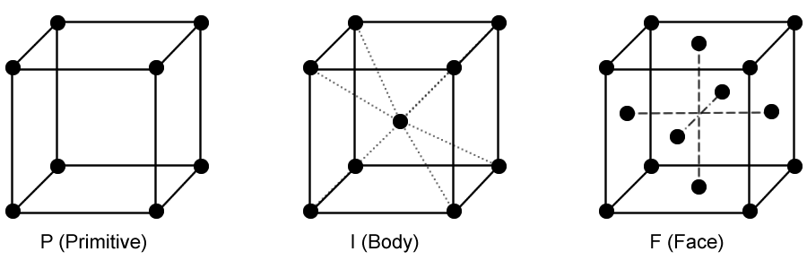
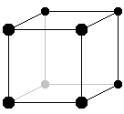
Lattice types
Primitive
(P)
Body centered (I)
Face centered (F)
Base centered (C)
Lattice types (animation)

Slide 28
14 Bravais lattices
Crystal system | Primitive (P) | Body centered (I) | Face centered (F) | Base centered (C)
Cubic |  |  |  | ×
Tetragonal |  |  | × | ×
Orthorhombic
Monoclinic |  | × | ×
Triclinic |  | × | × | ×
Rhombohedral |  | × | × | ×
Hexagonal |  | × | × | ×
Click here for animation for 14 Bravais lattices

Slide 29
Atomic Packing Factor or Packing Fraction
It is the ratio of volume occupied by the atoms in a unit cell to the
total volume of the unit cell.
where, r = radius of atoms
a = unit cell edge
Z = no. of lattice points per unit cell
Now, we are going to apply this for three crystal structures
having cubic symmetry
Simple cubic
Body centered cubic
Face centered cubic

Slide 30
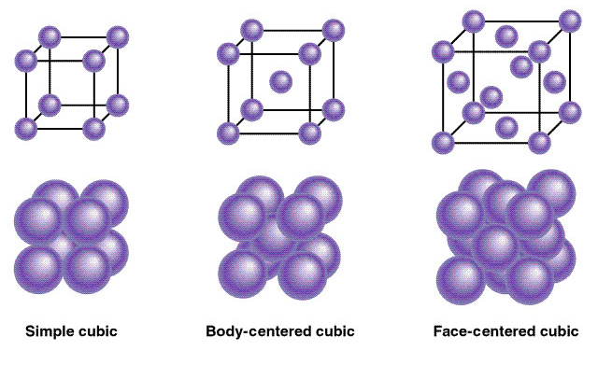

Slide 31
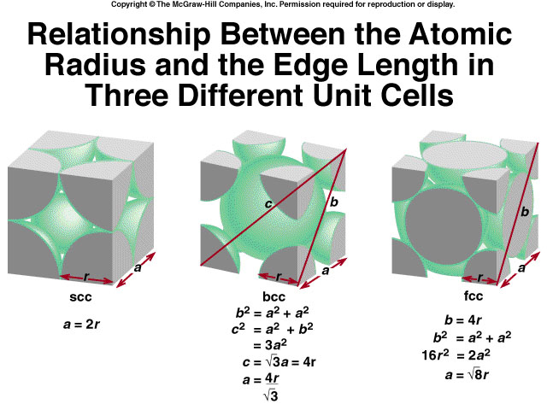
Relation between atomic radius and edge length

Slide 32
Simple cubic
Body centered cubic
Face centered cubic
Z = 1
Z = 2
Z = 4
PF = 52%
PF = 68%
PF = 74%

